Slide 1
DNA
Deoxyribonucleic Acid

Slide 2
Question to Ponder
We know what dominant and recessive mean, but what actually makes one trait dominant over another trait?

Slide 3
Here’s the brief answer:
The gene that produces the dominant trait contains information to make a functional protein.
The gene that produces the recessive trait contains information to make a non-functional protein.
In a codominant situation, the genes have the information for two different functional proteins.

Slide 4
What is a gene?
http://learn.genetics.utah.edu/content/begin/tour/

Slide 5
Function of DNA
To store & transmit the genetic info. that tells cells which proteins to make and when to make them.
These proteins then help control chemical processes within cells, they determine your traits.

Slide 6
Structure of DNA
DNA is made up of 2 chains of nucleotides
Each nucleotide has 3 parts:
Deoxyribose sugar
Phosphate group
Nitrogenous base (1 of 4)
Adenine (A)
Guanine (G)
Cytosine (C)
Thymine (T)

Slide 7
More Info.
The double-helix shape of DNA was discovered by Watson & Crick (1953), using some of the work done by Franklin & Wilkins.
Deoxyribose sugar and phosphate group alternate to form a “backbone” to which nitrogenous bases attach – connected by covalent bonds
Weak hydrogen bonds form between the nitrogenous bases of the two strands

Slide 8
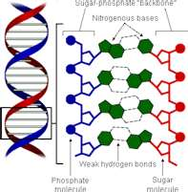
DNA Model

Slide 9
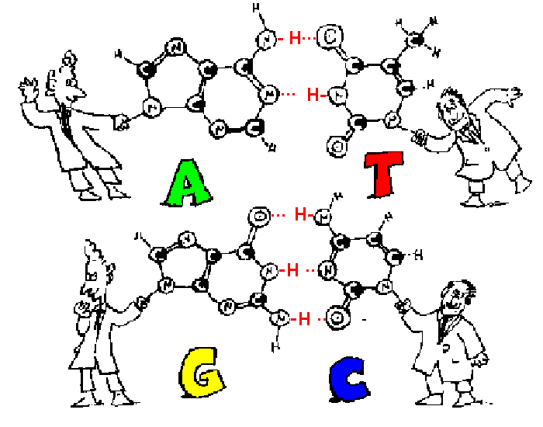
Base-Pairing
Adenine pairs with thymine (2 hydrogen bonds)
Cytosine pairs with guanine (3 hydrogen bonds)
This forms complementary strands
Side1:: A A T T G G C C Side2:: T T A A C C G G

Slide 10
If all organisms are made of the same 4 nucleotides in their DNA, how are they so different?
Every organism has a different DNA sequence, which provides different information
TEAR – RATE – TARE – TAR – RAT – TEA
The more closely related 2 organisms are, the more similar their DNA nucleotide sequences will be.

Slide 11
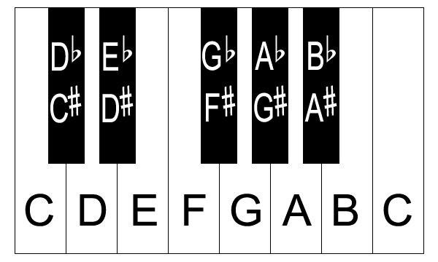
Another Example
There are 12 different notes, but millions of different songs.

Slide 12
DNA Replication

Slide 13
When a cell divides, how does the DNA get copied?
Remember that DNA gets copied during the S phase of interphase prior to mitosis or meiosis.
This process is called DNA replication.

Slide 14
DNA Replication
DNA Replication Animation

Slide 15
DNA Replication: How it works
1) Enzymes called helicases “unzip” the 2 DNA strands at the replication fork by breaking the hydrogen bonds between the nitrogenous bases.
2) Enzymes called DNA polymerases add complementary free-floating nucleotides to each of the original strands.
3) The nucleotides bond together and DNA polymerases are released when they finish replicating the DNA & DNA ligase binds the pieces of DNA together.
RESULTS: 2 separate and identical DNA molecules, each containing an original strand and a new strand of DNA.
Semiconservative replication

Slide 16
Steps of Replication Summary
1) DNA strands pulled apart by helicase @ rep. fork
2) SSBs bind to keep strands apart
3) RNA primase adds RNA primer
4) DNA polymerase adds DNA nucleotides starting @ primer
5) RNase H removes RNA primer
6) Gaps filled in by DNA polymerase
7) DNA ligase joins Okazaki fragments

Slide 17
How does DNA get copied so quickly?
Replication begins at thousands of points along a DNA molecule in eukaryotes, requiring thousands of helicases & DNA polymerases
In prokaryotes, the chromosome is circular, so replication begins at one site and proceeds in opposite directions until the entire molecule is copied.

Slide 18
How accurate is DNA replication?
If a mistake is made, DNA polymerase normally fixes it.
There is only about 1 error per billion nucleotide pairs.
Any error in DNA replication is called a mutation and it can have serious consequences, some good and some bad.

Slide 19
Assignment
Read Sec. 12-2
Complete p. 335 #1-5

