Slide 1
Cellular Transport
Section 7-4

Slide 2
Passive Transport
Transport of substances across the plasma membrane that requires no input of energy.
Types: Diffusion, facilitated diffusion, osmosis

Slide 3
What is diffusion?
Diffusion is the movement of particles from an area of higher concentration to an area of lower concentration.
http://highered.mcgraw-hill.com/sites/0072495855/student_view0/chapter2/animation__how_diffusion_works.html
Example: You can observe this with food coloring in water or when someone sprays perfume

Slide 4
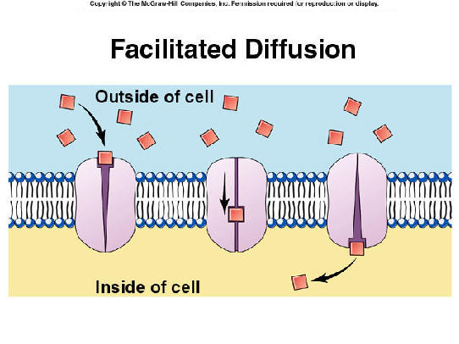
Facilitated Diffusion
Since most substances can’t diffuse through the plasma membrane on their own, they must pass through transport proteins.

Slide 5
Osmosis
Osmosis is the diffusion of water across a selectively permeable membrane.
The cell maintains homeostasis by regulating water flow through the plasma membrane.

Slide 6
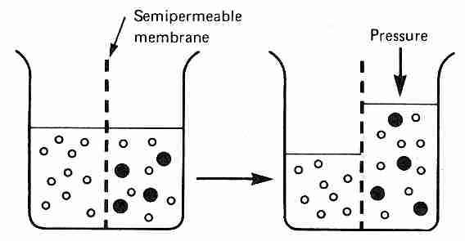
Osmosis
In osmosis, water moves to where the water is less concentrated and where the solute is more concentrated.

Slide 7
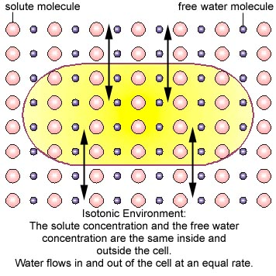
How Osmosis Affects Cells
In an isotonic solution, water concentration is equal on both sides of the membrane – water moves equally back and forth.

Slide 8
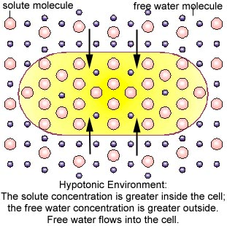
How Osmosis Affects Cells
In a hypotonic environment, the concentration of solute is lower outside the cell than inside – water enters the cell by osmosis
This causes the cell to swell
If the cell bursts, lysis has
occurred.

Slide 9
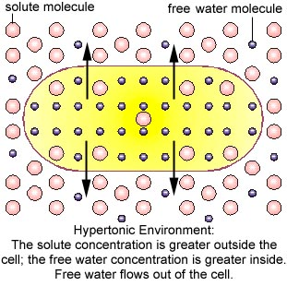
How Osmosis Affects Cells
In a hypertonic environment, the concentration of solute is higher outside the cell than inside – water leaves the cell by osmosis
This causes the cell to
shrink (plasmolysis)

Slide 10
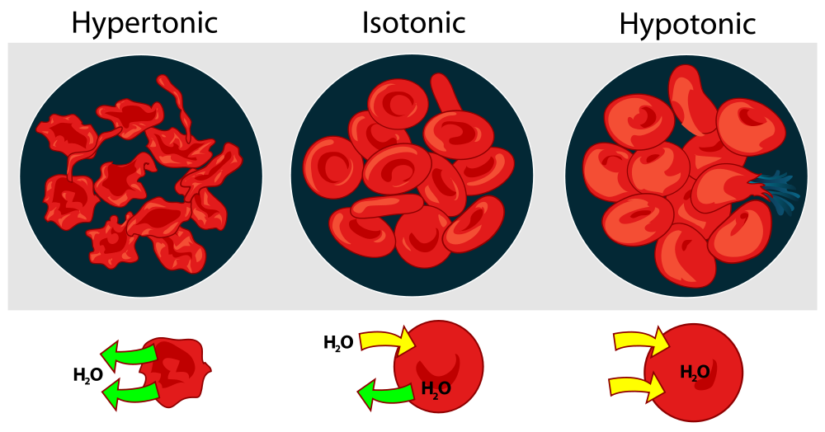
Red blood cells

