Slide 1
Theory of evolution
Chapter 15

Slide 2
History of Evolutionary Thought
Section 15-1

Slide 3
History of Evolutionary Thought
In 18th century Europe, it was believed that life had never changed in the few thousand years that life had existed on Earth.
However, scientists began studying rock layers (strata) and learned more about geology and living things of the past.

Slide 4
Influential Scientists
Cuvier’s Discoveries
Lyell’s Idea
Some past organisms differ greatly from living species
Some organisms became extinct
BIG IDEA: Geology and life had changed
Uniformitarianism
Geologic processes that have changed the shape of the Earth’s surface in the past continue to work in the same ways.

Slide 5
Another Influential Scientist
Jean Baptiste Lamarck’s Ideas
Simple life forms develop into more complex forms
Individuals can acquire traits during their lifetime and pass on those traits to their offspring (inheritance of acquired characteristics)

Slide 6
What does “Inheritance of Acquired Characteristics” Mean?
Example: A population of giraffes all had short necks and were able to reach their food. However, when they were forced to move to an area with taller trees, they could no longer reach their food. So they stretched and stretched until they could reach. Then when Mr. & Mrs. Giraffe had babies, their babies had long necks because their parents had acquired long necks.

Slide 7
In other words…
The changing environment changes a need and the modification results from that need.

Slide 8
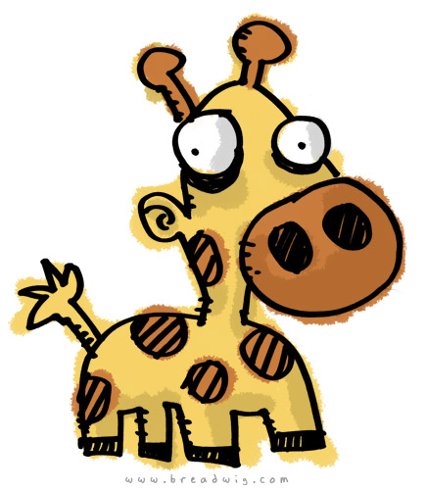
Just because…
Louis the Short-Necked Giraffe

Slide 9
Charles Darwin
Darwin sailed around the world on the H.M.S. Beagle in the mid-1800s and became the ship’s naturalist.
He made observations, kept journals, and collected bones and specimens.
He observed that a number of fossil organisms he found were very similar to living organisms.
He observed that similar organisms existed in very different locations.

Slide 10
Darwin’s Ideas
He described evolution with the phrase “descent with modification,” meaning that all species descended from preexisting species but changed over time.
For example, there are 13 species of finches on the Galapagos Islands, each containing a beak that is best adapted to a certain type of food. He believed that they all descended from a common ancestor.

Slide 11
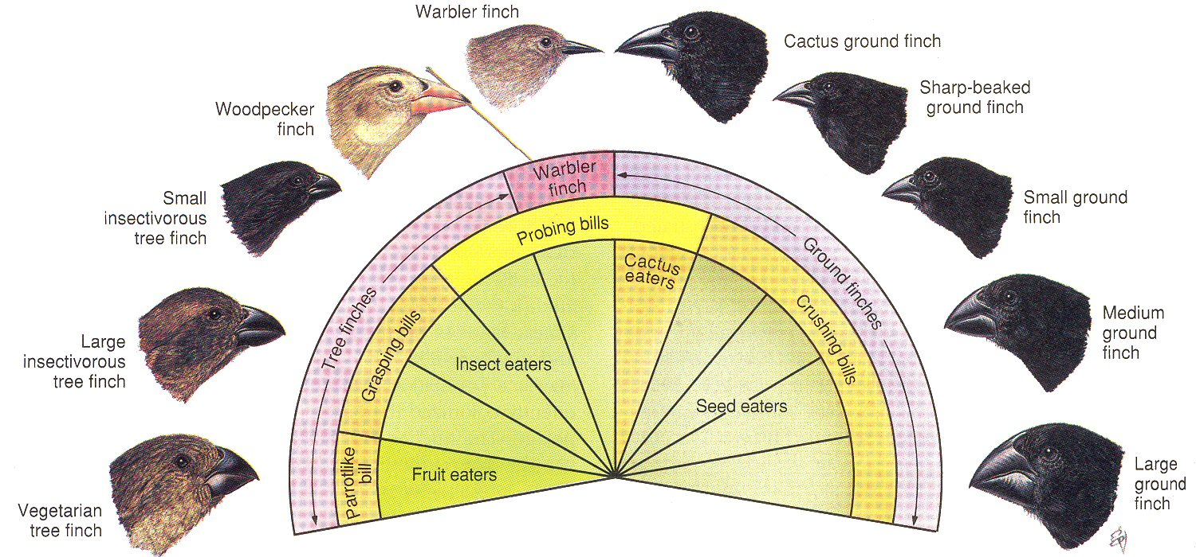
Darwin’s Finches

Slide 12
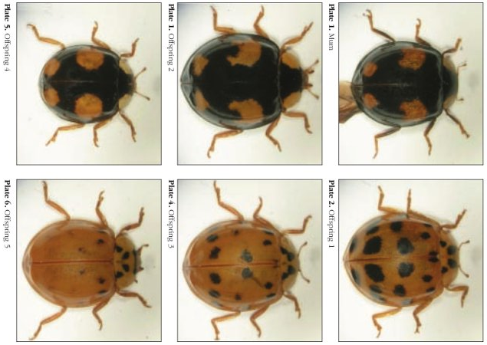
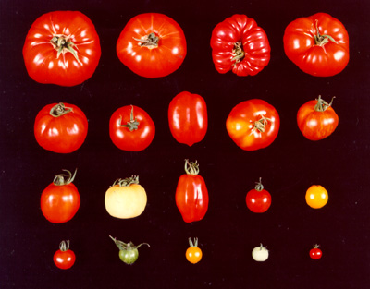
The Mechanism for D.W.M.
Darwin proposed natural selection as the mechanism for descent with modification.
4 Requirements for natural selection:
1) Overproduction – More offspring produced than can survive
2) Genetic Variation—Individuals in a population have different traits, mostly inherited, sometimes new

Slide 13
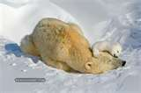
Requirements for natural selection
3) Struggle to Survive—Individuals must compete for limited resources, avoid predators, disease, and unfavorable conditions
A trait that makes an individual successful in its environment is an adaptation.
4) Differential Reproduction—
Individuals that have certain traits
are more likely to survive and reproduce than are individuals that lack those traits. Over time, those traits become more frequent in the population.

Slide 14
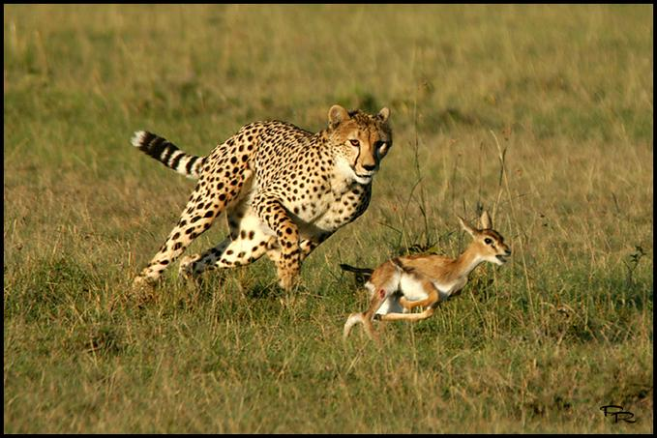
Survival of the Fittest
Fitness refers to one’s ability to survive to maturity and reproduce.
If a certain trait increases one’s fitness, it will likely increase in the population. These are adaptations (e.g. speed, agility).

Slide 15
Evidence of Evolution
Section 15-2

Slide 16
The Fossil Record
Oldest fossils tend to be lower in the strata than newer fossils.
Based on these strata, we can tell when different organisms lived.
We can tell where different organisms lived.

Slide 17
Fossils
We can see that species have differed in a gradual sequence of forms over time.
This is based on transitional species, which have features intermediate between those of hypothesized ancestors and later descendent species.
When looking at transitional species, researchers look at derived traits (newly evolved) and ancestral traits (old, primitive).

Slide 18
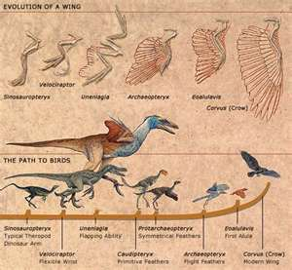
Transitional Species

Slide 19
Biogeography
Similar species adapted to different environments in the same area
Seemingly unrelated species had similar adaptations to similar environments in different areas
Some features are only found in one region
Example: Most mammals on Australia are marsupials – probably evolved in isolation

Slide 20
Anatomy
Homologous structures occur in different species, have a related structure originating with a common ancestor, may have different functions
Analogous structures have closely related functions but do not come from a common ancestor
Vestigial structures no longer serve the purpose that they did in an ancestor.

Slide 21
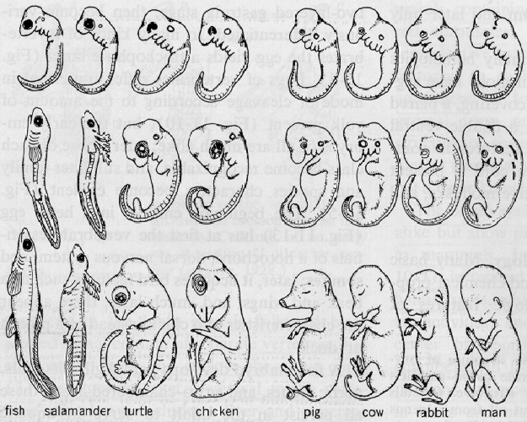
Embryology
The embryos (earliest stage of fetal development) of many organisms are very similar.
This shows that these
animals likely had a
common ancestor

Slide 22
Biological Molecules
We can look at DNA sequence or amino acid sequence to see how closely related organisms are.

Slide 23
ADAPTATION
An adaptation is a trait shaped by natural selection that increases an organism’s reproductive success.
Fitness is the number of viable offspring that an organism produces, shows how effective a trait is in contributing to reproductive success.
Examples: camouflage, mimicry, antibiotic resistance

Slide 24
Evolution in Action
Section 15-3

Slide 25
Patterns of Evolution
Divergent Evolution
One ancestral species evolves into a number of different species.
Adaptive Radiation
A type of divergent evolution in which a species evolves into many different species that all fit different parts of the environment.
Ex. Darwin’s finches

Slide 26
Patterns of Evolution
Convergent Evolution
Different species become more similar due to similar environments

