Slide 1
Viruses
Section 18-2

Slide 2
Question Set #1
1. Not all viruses are harmful.
2. Viruses aren’t considered living because they aren’t made of cells, they don’t metabolize nutrients, etc.
3. HIV, herpes, polio, & smallpox are examples of human viral diseases.
4. Viruses are smaller than bacteria.

Slide 3
Question Set #2
1. Viruses are thought to have originated with cell parts.
2. A bacteriophage is a virus that infects bacteria.
3. Different types of viruses are structured differently, but all viruses are composed of a nucleic acid (DNA or RNA) and a protein coat (capsid).

Slide 4
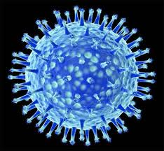
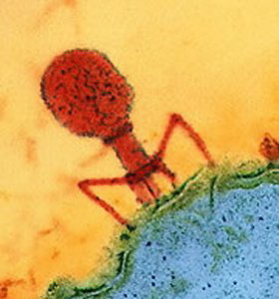
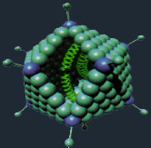
Viruses

Slide 5
Question Set #3
1. Before a virus can replicate, it must enter a host cell.
2. Many viruses can’t be transmitted between species because different types of organisms have receptors for different types of viruses.

Slide 6
Question Set #4
The Lytic Cycle stages:
1. Attachment of a virus to host cell
2. Virus injects its nucleic acid
3. Host cell makes copies of viral RNA or DNA & then these viral genes instruct the host cell to make more viral proteins and enzymes needed for replication
4. New viral particles are assembled
5. New viruses leave the host cell by exocytosis or by causing the cell to burst (lysis)
Animation

Slide 7
Question Set #4 continued
2. You could tell if you had a virus that reproduced via the lytic cycle because you would have an active infection.
3. Common colds and influenza (flu) are active infections caused by lytic cycle viruses.

Slide 8
Question Set #5
1. The lysogenic cycle is different from the lytic cycle in that the viral DNA gets integrated into the host’s chromosome, where it may remain dormant for some time.
2. It’s possible for someone to have a virus for years and not know it because it hasn’t been activated. Activation can occur for a number of reasons, during which time the virus enters the lytic cycle & an active infection occurs.
3. An example of a lysogenic cycle virus is herpes simplex I, which causes cold sores.

Slide 9
Lytic vs. Lysogenic Cycles
Lytic cycle = host cell being hijacked and then killed
Typical length: 30 minutes
# new viruses produced: 200
Result for host cell: Death
Lysogenic cycle are like sleeper cells – they are subtly integrating into the host’s genetic material

Slide 10
Question Set #6
1. A retrovirus contains RNA instead of DNA.
2. HIV, human immunodeficiency virus, is a retrovirus.

Slide 11
Question Set #6 continued
3. Retroviruses contain RNA and an enzyme called reverse transcriptase, which transcribes DNA from viral RNA.
The DNA enters the nucleus of the host cell & integrates into the chromosome.
When it’s activated, viral DNA is transcribed to RNA & translated into viral proteins, which assemble into new viruses.

Slide 12
Question Set #7
1. A prion is a protein that can cause infection or disease (a proteinaceous infectious particle).
They are normally in our cells & are coil-shaped.
If they are coded for by a mutated gene, they fold incorrectly & have negative consequences.

Slide 13
Question Set #7 continued
2. Mutated prions cause diseases called transmissible spongiform encephalopathies, such as:
Mad cow disease in cows
Creutzfeldt-Jakob disease in humans
Scrapie in sheep
Chronic wasting disease in deer & elk

Slide 14
Question Set #7 continued
3. Prions cause normal proteins to mutate.
4. Prions cause nerve cells in the brain to burst, which leaves spaces in the brain (sponge-like).
It’s thought that prions may be transmitted from cattle to humans when contaminated beef is eaten.

