Slide 1
Chemical Reactions
Section 6-2

Slide 2
What is a chemical rxn?
It’s the process by which atoms in substances are reorganized into different substances.
In other words, bonds are broken, atoms are rearranged, and new bonds form.
Indicators: color &/or texture change; formation of a solid, liquid, or gas; production of heat or light

Slide 3
Chemical Equations
Reactants → Products (→ = “yields”)
The number of atoms of each element must be the same on each side of the equation.
C₆H₁₂O₆ + 6O₂ → 6CO₂ + 6H₂O
6 C 6 C
12 H 12 H
18 O 18 O

Slide 4
Getting Reactions Started
Most reactions require an input of energy before they can get started (activation energy).
Activation energy often is in the form of heat.

Slide 5
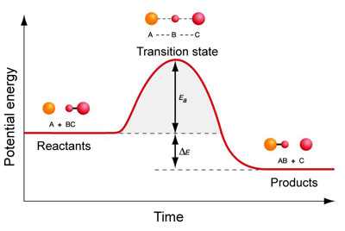
Energy Changes in Reactions
If the amount of energy in the reactants is more than the energy in the products, this rxn is called an exothermic rxn (ex0- = out)
These reactions release heat.
It’s what keeps our body temperature constant.

Slide 6
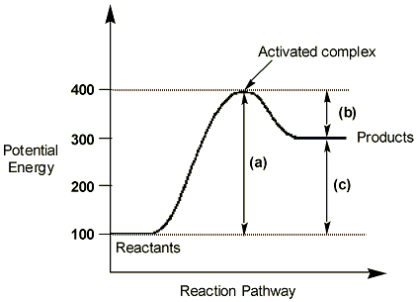
Energy Changes in Reactions
If the amount of energy in the reactants is less than the energy in the products, this rxn is called an endothermic rxn (end0- = in)
These reactions absorb heat, feel cold
This is what makes a cold compress (“ice pack”) cold

Slide 7
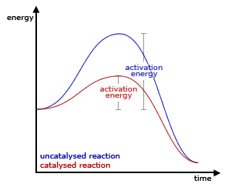
Catalysts
Some reactions require so much activation energy that they don’t occur very often.
In order to lower the amount of a.e. needed, a catalyst can be used to speed up the reaction.

Slide 8
Enzymes
Enzymes are biological catalysts that speed up rxns in biological processes.
Enzymes are used, but are not used up during the chemical rxn and can therefore be used again.
They are specific to the reaction, like a lock & key
-ase = enzyme
Lactase breaks down lactose
Amylase breaks down amylose

Slide 9
How do enzymes work?
The reactants that bind to the enzyme are substrates.
Substrates may be multiple reactants that need to be bound together or they may be one reactant that needs to be broken down.
The substrate finds the active site on the enzyme
The enzyme fits snugly around the substrate to form the enzyme-substrate complex.
The e-s complex helps break bonds in the reactants & form new ones in the products.

Slide 10
How do enzymes work?
After the products are made, they are released.
The enzyme returns to its original shape.
Enzyme animation

Slide 11
What affects enzymes?
Enzymes’ shapes can be altered by excessive temperature, pH, etc.
They can never return to their original shape & therefore can’t function appropriately.
Shape change = “denatured”

