Slide 1
Genetics – Types of Inheritance

Slide 2
Test Cross
This is done to determine if an organism with a dominant trait is homozygous or heterozygous
Cross the unknown with a __________________.
If any of the offspring are recessive, the unknown must have been __________________.
T T? T t?
t t t
t t t
Tt
Tt
Tt
tt
Tt
Tt
Tt
tt

Slide 3
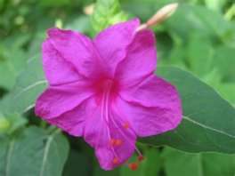
Incomplete Dominance
Produces a phenotype that is an intermediate (a blend) of the dominant trait and the recessive trait in a heterozygote.
Example: In four o’clock flowers, the alleles for red flowers (C^{R}) and white flowers (C^{W}) both influence the phenotype
C^{R}C^{R} = red
C^{W}C^{W} = white
C^{R}C^{W} = pink

Slide 4
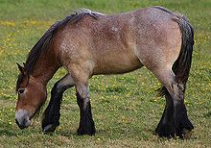
Codominance
Occurs when both alleles for a gene are expressed
Example: Roan horses are a combination of white and red horses
Human example: AB blood type - Type A proteins & type B proteins both show up on blood cells

Slide 5
Multiple Alleles
Some traits are determined by more than two alleles. These are multiple allele traits.
Example: Human blood type
Alleles: I^{A}, I^{B}, i
Blood Type | Possible Genotypes
A | I^{A}I^{A} or I^{A}i
B | I^{B}I^{B} or I^{B}i
AB | I^{A}I^{B} (codominant)
O | ii

Slide 6
Chromosomes in Humans
Humans have 23 pairs of chromosomes
22 pairs of autosomes
1 pair of sex chromosomes
Contain genes that determine gender
XX = female, XY = male
Sex-Determination X Y
50% chance for male
50% chance for female X
Who determines gender?
X
XX
XY
XX
XY

Slide 7
Sex Chromosomes
Genes located on the X chromosome are X-linked genes.
Genes located on the Y chromosome are Y-linked genes.
Sex-linked traits are coded for by an allele on a sex chromosome.
More on X chromosome because it’s larger
Because males only have one X chromosome, if they carry a recessive allele on the X chromosome, they exhibit the trait.
Examples: color-blindness, hemophilia

Slide 8
Mutations
Germ-cell mutations occur in gametes
Affect offspring only
Somatic-cell mutations occur in body cells
Affect the organism only, not inherited
Lethal mutations cause death, often before birth
Some mutations are beneficial and give an organism an evolutionary advantage.

Slide 9
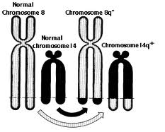
Chromosome Mutations
Deletion – loss of a piece due to breakage
Inversion – a piece breaks off, flips, and reattaches
Translocation – a piece breaks off and reattaches to a nonhomologous chromosome

Slide 10
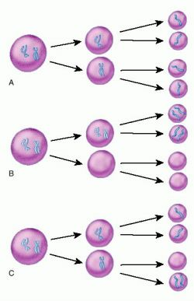
Chromosome Mutations
Nondisjunction – a chromosome fails to separate from its homologue during meiosis
One gamete gets an extra copy, the other gets no copies
Example: Down’s syndrome is caused by 3 copies of the 21st chromosome

Slide 11
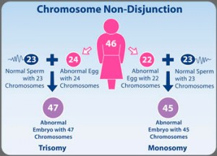
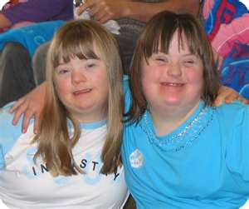
Nondisjunction
Down’s Syndrome
-Trisomy 21

Slide 12
Gene Mutations
Point Mutation – A mutation in a single nucleotide
Substitution – one nucleotide changed for another
C = A instead of C = G
Frameshift Mutation – Results when all of the codons are changed due to an addition or deletion of a nucleotide
Addition – one nucleotide added
Deletion – one nucleotide removed

