Slide 1
Chapter 7
Section 7-1
Microscopes/Cell Theory and Eukaryotic and Prokaryotic Cells

Slide 2
Section Essential Questions
How are the advances in microscope technology related to discoveries about cells?
What are the similarities and differences between compound light microscopes and electron microscopes?
What are the principles of the cell theory?
What are the differences between a prokaryotic cell and a eukaryotic cell?

Slide 3
Section 7.1 Summary – pages 171-174
Before Microscopes
What was believed to cause illnesses?
The Invention of Microscopes
Lead to discovery of Microorganisms
Discovery of cells as the basic unit of life

Slide 4
Section 7.1 Summary – pages 171-174
The Cell
Robert Hooke was an English scientist ~1665.
Hooke used a compound light microscope to study cork, the dead cells of oak bark.
Determined that cells are the basic building blocks of all living things.

Slide 5
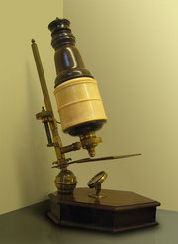
Hooke’s microscope
Cork cells

Slide 6
Section 7.1 Summary – pages 171-174
Development of Light Microscopes
Anton van Leeuwenhoek – first person to observe living cells under a microscope
Late 1600s
Simple light microscope: one lens and light

Slide 7
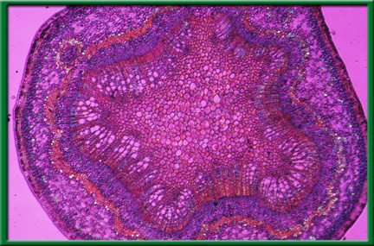
Section 7.1 Summary – pages 171-174
Development of Light Microscopes
Compound light microscopes: more than one lens and light
Magnify up to 1,500 X.

Slide 9
Over time (hundreds of years) new research lead to the development of the:
Cell Theory
(mid 1800’s)

Slide 10
Section 7.1 Summary – pages 171-174
The cell theory is made up of three main ideas:
All organisms are composed of one or more cells.
The cell is the basic unit of structure & organization of all living organisms.
All cells come from pre-existing cells. (They pass on copies of genetic material to daughter cells.)

Slide 11
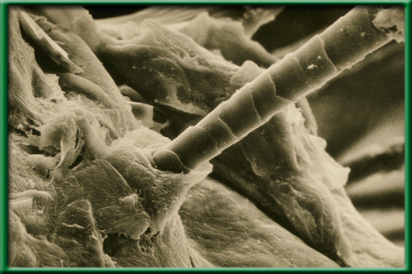
Section 7.1 Summary – pages 184-185
Development of Electron Microscopes
The electron microscope was invented in the 1940s.
Beam of electrons used to magnify objects

Slide 12
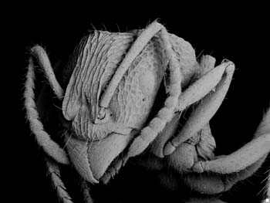
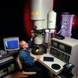
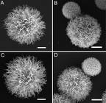
Section 7.1 Summary – pages 171-174
Development of Electron Microscopes
Types of electron microscopes:
Scanning electron microscope (SEM) scans the surface of an object – captures 3-D shape. (20,000X mag)
Yeast cells
ANT

Slide 13
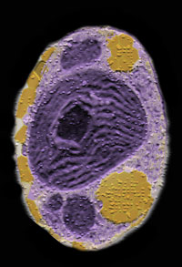
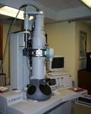
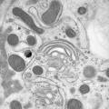
Section 7.1 Summary – pages 171-174
Development of Electron Microscopes
Types of electron microscopes:
The transmission electron microscope (TEM) looks at cross section of an object or cell (500,000X mag)
Mouse cell
Single-celled algae

Slide 14
Basic Cell Types

Slide 15
Cell Diversity
Cells vary in shape, which relates to their function
Skin cells are flat to cover the body
Nerve cells are branched to transmit impulses
Cells vary in size: size is limited by the surface area-to-volume ratio
If a cell’s volume gets too large, its exchange of substances would take too long and the cell could die

Slide 16
How are cells similar?
All cells have a plasma (cell) membrane.
Most cells have genetic material
Cells break down molecules for energy

Slide 17
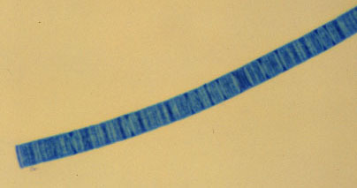
Section 7.1 Summary – pages 171-174
Two Basic Cell Types
Prokaryotic cells : cells that do not contain internal membrane-bound structures (organelles)
Examples: Bacteria and some other single celled organisms
Blue Green Algae
Blue Green Algae
Bacteria

Slide 18
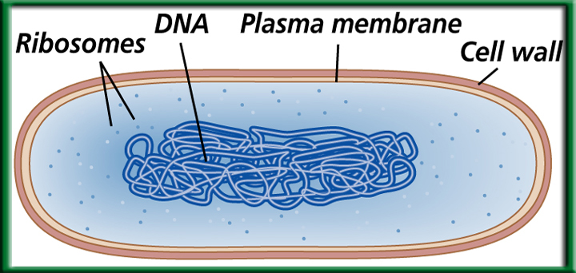
Prokaryotic cells
Basic structure

Slide 19
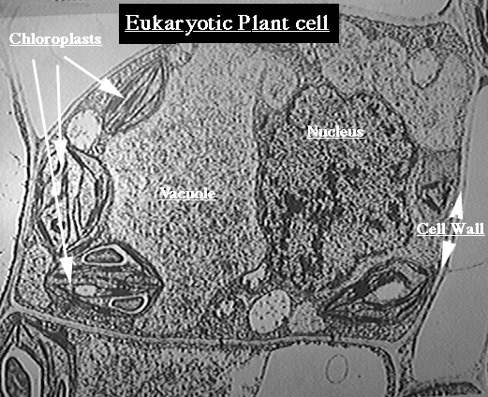
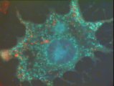
Section 7.1 Summary – pages 171-174
Two Basic Cell Types
Eukaryotic cells: contain membrane-bound structures .
Examples: all plant and animal cells – some single celled organisms

Slide 20
Eukaryotic cells

Slide 21
Eukaryotic v. Prokaryotic

Slide 22
Section 7.1 Summary – pages 171-174
Basic Parts of a Cell
Plasma membrane – Cell’s outer boundary
Organelles- membrane-bound structures within eukaryotic cells.
Each organelle has a specific function that contributes to cell survival.
Cytoplasm-The region within the cell
Nucleus-The central membrane-bound organelle that manages cellular functions in eukaryotes.

Slide 23
Section 1 Check
Question 1
How did the invention of the microscope impact society's understanding of disease?
A. Scientists were able to view microorganisms that were previously unknown.
B. Microscopes were invented after the development of the cell theory.
C. It was once believed that viruses, not bacteria, caused diseases.
D. Scientists could view membrane-bound organelles of prokaryotes.

Slide 24
Section 1 Check
The answer is A. Before microscopes were invented, people believed that curses and supernatural spirits caused diseases. Microscopes enabled scientists to view cells, which led to the discovery that microorganisms cause some diseases.

Slide 25
Section 1 Check
Question 2
Which of the following uses a beam of light and a series of lenses to magnify objects in steps?
A. compound light microscope
B. scanning electron microscope
C. transmission electron microscope
D. simple light microscope

Slide 26
Section 1 Check
The answer is A. Most microscopes use at least two convex lenses. Compound light microscopes use a light beam and a series of lenses and can magnify objects up to about 1500 times. Electron microscopes use a beam of electrons and can magnify structures from 20,000 to 500,000 depending on the type of microscope.

Slide 27
Section 1 Check
Question 3
What makes this cell eukaryotic?
A. Because it has a cell wall.
Nucleus
B. Because it contains DNA.
Nucleolus
C. Because it has membrane-bound organelles.
Chromosomes
Organelles
Plasma membrane
D. Because it does not have DNA.

Slide 28
Section 1 Check
Question 3
The Answer is C. Eukaryotic cells contain membrane-bound organelles that have specific functions in the cell; prokaryotic cells do not.
Nucleus
Nucleolus
Chromosomes
Plasma membrane
Organelles

