Slide 1
Populations
Chapter 4

Slide 2
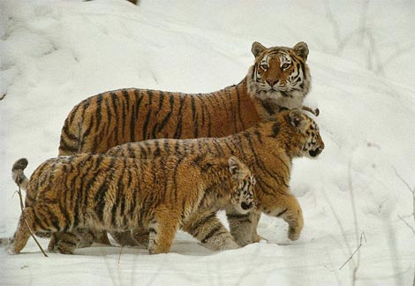
Review
A population is a group of organisms, all of the same species, that live in a specific area.

Slide 3
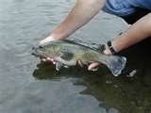
How is Population Size Estimated?
Mark-recapture method
Individuals are captured, marked, and released
Researchers obtain another sample later and keep track of those already marked
A formula is used to estimate the pop. size.
Random Sampling
Apply # of individuals in sample to whole area

Slide 4
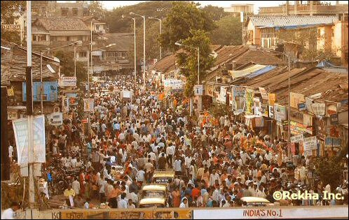
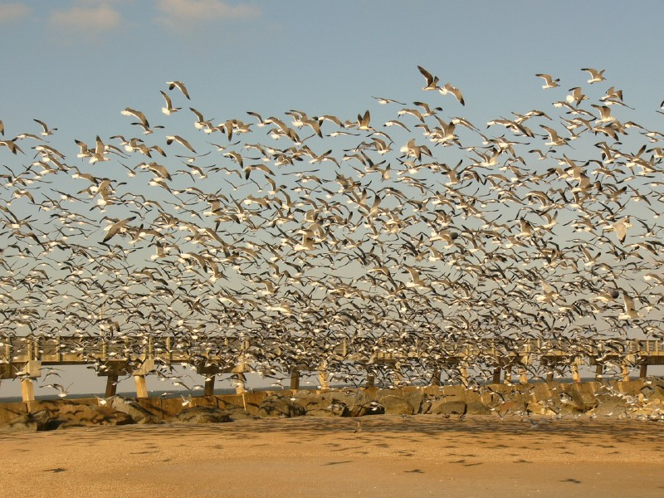
Population Density
It’s often more helpful to know the population density of a group, or how crowded it is.
It’s the # of individuals per unit area or volume.
If pop. density is too high, it can have serious consequences for the population.

Slide 5
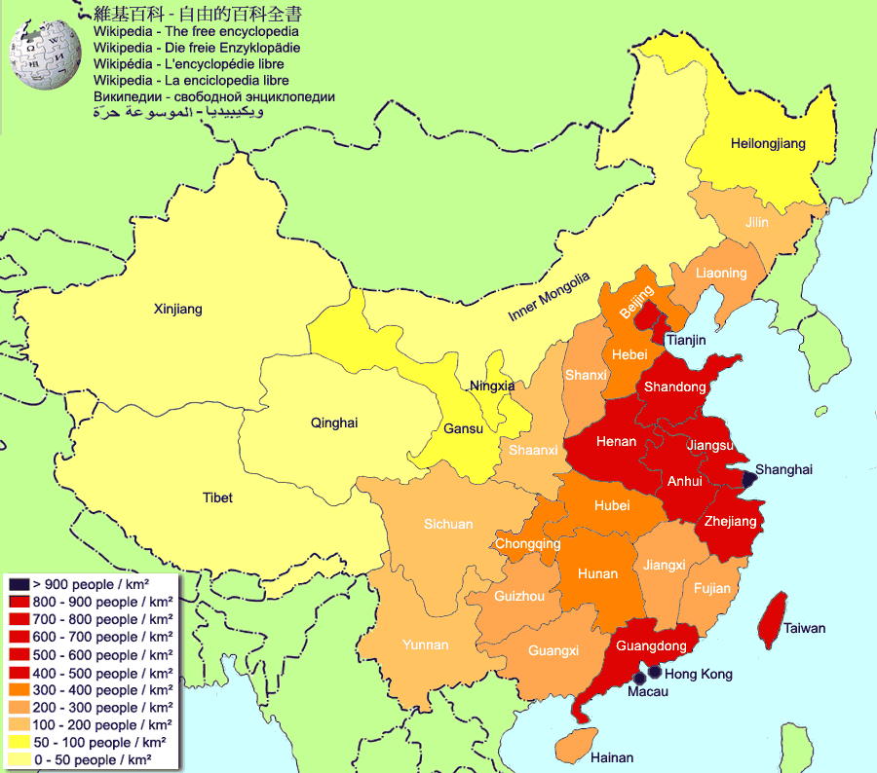
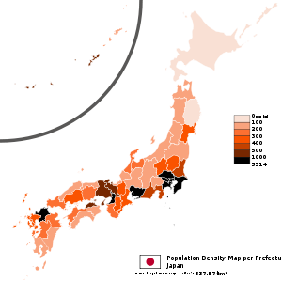
Population Density Comparison
china
japan
1.3 billion people
9.6 million km²
Pop. density: 135 people/km²
126 million people (10x less)
377,835 km²
(25x smaller area)
Pop. Density: 325 ppl/km²

Slide 6
Dispersion Patterns
Uniform
Organisms keep their space (ex. Black bears)
Clumped
Occurs where food or space is clumped or due to social nature of organisms (ex. Bison, ants, school of fish, bees)
Random
Most populations show some degree of uniformity or clumping. (ex. White-tailed deer)
See page 93

Slide 7
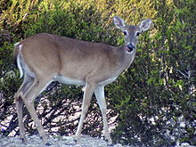
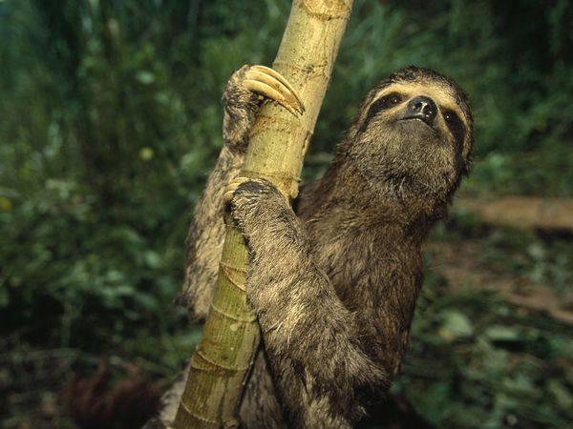
Population Range
Population range refers to the locations where a certain population can be found.
Some populations have a wide range, such as the white-tailed deer (N., C., & S. America)
Others have a narrow range, such as the three-toed sloth (northern S. America)

Slide 8
What limits the size of a population?

Slide 9
Limiting Factors
Density-independent factors can affect populations, regardless of their density.
Ex. Volcanic eruptions, floods, pesticides, pollution
Density-dependent factors have an increasing effect as the population increases.
Ex. Disease, predators, food supply, competition, crowding

Slide 10
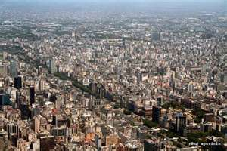
Disease
“The crowded metropolitan bus system in Buenos Aires could be responsible for 30 percent of new cases of tuberculosis in the city, a new study shows.”
Close contact between individuals increases transmission of diseases

Slide 11
Predation
See “Deer Predation or Starvation” worksheet for a graphical representation of the impact of predator and prey numbers on one another’s population size.

Slide 13
Population Dynamics
To know how a population changes, one must know the birth rate and the death rate.
Life expectancy is also important
In the U.S., the life expectancy for men is 74 years old, for women it’s 80.

Slide 14
Population Growth Rate
Birth rate – death rate = growth rate
When birthrate > death rate, the population
Immigration – Movement of individuals into a population
Emigration – Movement out of a population
When immigration > emigration, pop.

Slide 15
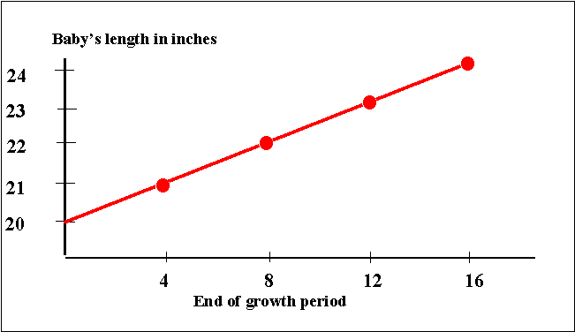
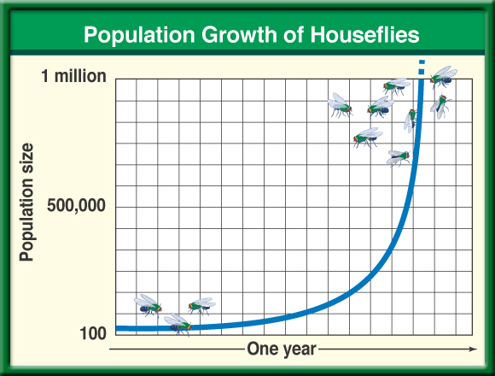
Exponential Model
Things that grow at an equal rate show linear growth.
Populations of organisms grow slowly at first and as the population grows and has more reproducing individuals, it grows faster. This is exponential growth. It is shown by a J-shaped curve.

Slide 16
Can a population grow indefinitely?
No, a population is limited by limiting factors, such as temperature, nutrients, predators, fire, etc.
Populations with plenty of resources have more births than deaths, so they grow until the environment is “maxed out.”
At this point, the population is at carrying capacity, it contains all the individuals that the environment can support.

Slide 17
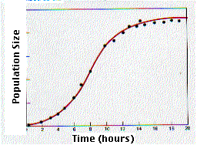
Logistic Model
Upon reaching carrying capacity, the pop. growth curve levels off and becomes an S-shaped curve.

Slide 18
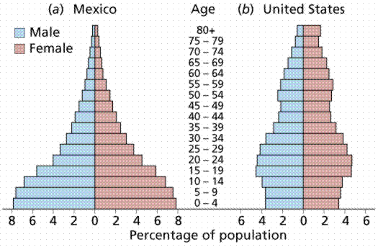
Age structure
Age structure refers to the proportions of the population that are in different age levels.
Wide base = rapidly growing (many young people)
Fairly even between ages = stable

Slide 19
Survivorship Curves
If an organism has a greater chance of dying at an early age, it shows a Type III survivorship curve
Ex. Plants, oysters, insects
If an organism has an equal chance of dying at any age, such as due to hunting or disease, it shows a Type II survivorship curve
Ex. Squirrels, reptiles
If an organism is likely to live at an early age, it shows a Type I survivorship curve
Ex. Humans

Slide 20
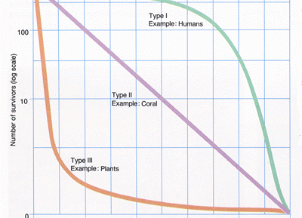
Survivorship Curves

