Slide 1
Introduction to plants
Plants Unit

Slide 2
Evidence that plants & green algae shared a common ancestor
They both:
Have cell walls containing cellulose
Store food as starch
Use same chlorophylls in photosynthesis
Undergo cell division that includes cell plate formation
Have same types of enzymes in cellular vesicles

Slide 3
What prevents water loss?
The cuticle – a waxy, waterproof covering
It keeps water and some microorganisms out

Slide 4
Stomata
Stomata are openings in the outer layer of leaves and some stems
They are most found on the bottoms of leaves
Why do you think this is true?

Slide 5
Vascular Tissue
Vascular tissue is specialized transport tissue
It enables faster movement of substances through the plant, over greater distances (allows the plant to grow larger)

Slide 6
Nonvascular Tissue
Nonvascular plants are those that lack specialized transport tissues
Substances move from cell to cell by osmosis and diffusion

Slide 7
Seeds
A seed is a plant organ that contains an embryo, nutrients for the embryo, and is covered by a protective coat.
Functions:
To protect the embryo from harsh environmental conditions (they only sprout when conditions are favorable)
To aid in the plant’s dispersal

Slide 8
Non-Seed Plants
Non-seed plants reproduce via spores, haploid cells capable of producing an organism
They require water for the sperm to reach the eggs

Slide 9
Alternation of Generations
Each plant has 2 life stages:
The sporophyte (generally the “normal” plant) has diploid cells
Through meiosis, these cells produce haploid spores.
Spores undergo cell divisions & become multicellular, haploid gametophytes (tiny)
Some of these gametophyte cells differentiate & become haploid gametes

Slide 10
Alternation of Generations, continued
When the sperm fertilizes the egg, it forms a diploid zygote.
The zygote undergoes mitosis & forms an embryo sporophyte
The cycle begins again

Slide 11
Characteristics of the plant kingdom
Chapter 22

Slide 12
Bryophytes (non-vascular)
Adaptations:
Rhizoids anchor them in soil, absorb water
Reproductive Structures:
Antheridium produces sperm (requires water)
Archegonium produces eggs
Transport of Materials:
Mostly osmosis
Spores
Examples: Mosses

Slide 13
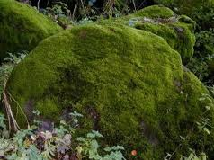
Bryophytes

Slide 14
Pterophytes (non-seed vascular)
Adaptations:
vascular tissue, become dormant when dry, rhizome (underground stem) stores starch
Reproductive Structures:
Antheridium (requires water) & archegonium
Transport of Materials:
Branched veins transport food & water
Spores (come from sori under the leaves)
Examples: ferns, horsetails

Slide 15
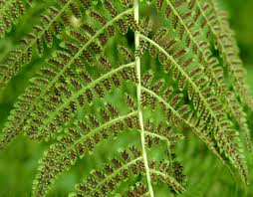
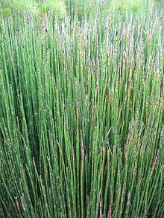
Pterophytes
Fern with sori
Horsetail

Slide 16
Gymnosperms/Coniferophytes (“naked seeds” - seed vascular)
Adaptations:
Pollen limits need for water
Seeds protect embryo
Reproductive Structures:
Cones (male & female)
Transport of Materials:
Vascular tissue
Seeds (after fertilization) & spores (before)
Examples: Pine, fir, cedar, spruce

Slide 17
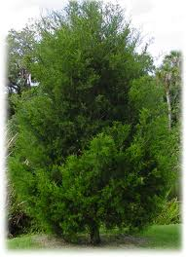
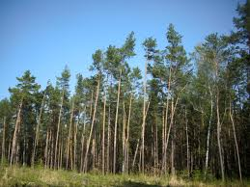
Gymnosperms

Slide 18
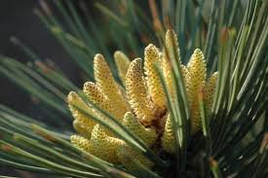
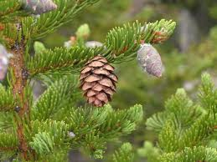
Gymnosperm Cones
Male
Female

Slide 19
Angiosperms/Anthophytes (“enclosed seed” –seed vascular, flowering plants)
Adaptations:
Vascular tissue
Seeds produced in fruits (dispersal & protection)
Reproductive Structures:
Seeds, stamen & pistils on flowers
Transport of Materials: vascular tissue
Seeds
Examples: Magnolia, maple, apple

