Slide 1
Changes in ecosystems
Standard 17.4: Describe changes in ecosystems resulting from seasonal variations, climate change, and succession.

Slide 2
Succession
Section 3-1

Slide 3
What characteristics does a community have?
Species richness
The number of species in the community
Varies by latitude
Closer to the equator = greater species richness

Slide 4
What characteristics does a community have?
How it responds to disturbance
Disturbances are events that change communities (the organisms or the resources available)
Examples: fires, droughts, volcanic eruptions, storms
Response can be good for species not normally given an opportunity to grow
Depends on the stability of the community

Slide 5
How does a community respond when there is a disturbance?
The community experiences succession, a gradual, sequential regrowth of the species in the community.
Two types of succession
Primary succession
Secondary succession

Slide 6
Comparing the Types of Succession
Primary succession
Secondary succession
Occurs where life has never before existed or where life was completely wiped out (ex. On an island formed from a volcanic eruption or on bare rock)
There is NO SOIL
Occurs following the disruption of an existing community (ex. Fire, tornado, farming, etc.)
SOIL IS PRESENT

Slide 7
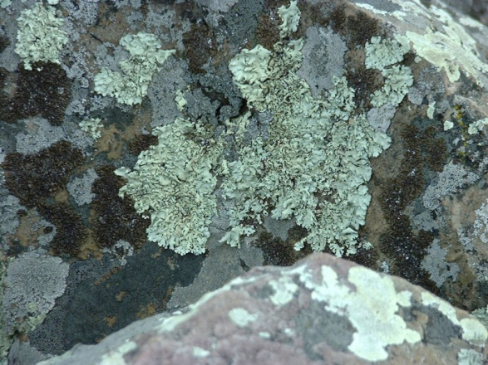
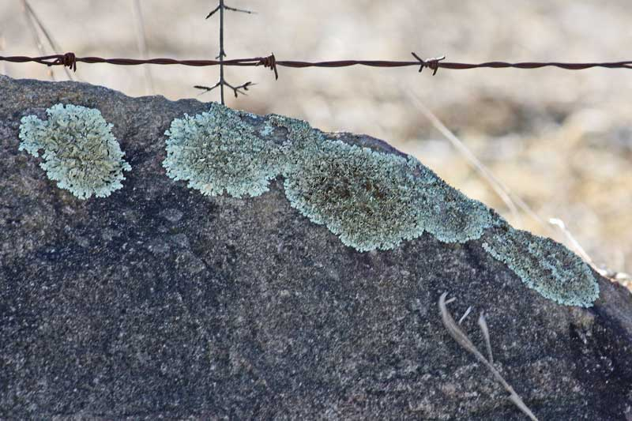
Succession Stages
The first species to dominate is called the pioneer species
Primary example: On bare rock, lichens (mutualistic relationship between fungi and algae) live and form soil by chemically weathering the rock.
With soil available, plants can move in.
With plants available, animals can move in.

Slide 8
Succession Stages
Secondary example
Grasses and weeds begin the process
Perennial grasses and shrubs take over
Softwood trees (pines) compete with shrubs for sunlight and nutrients, dominate
Ends with deciduous forest community (hardwoods)
A climax community is the stable endpoint of succesion.

Slide 9
Animations
Example of Secondary Succession
http://teachers.ecoplexity.org/node/496
Animated drawing
Primary Succession

