Slide 1
The Plasma Membrane
Section 7.2

Slide 2
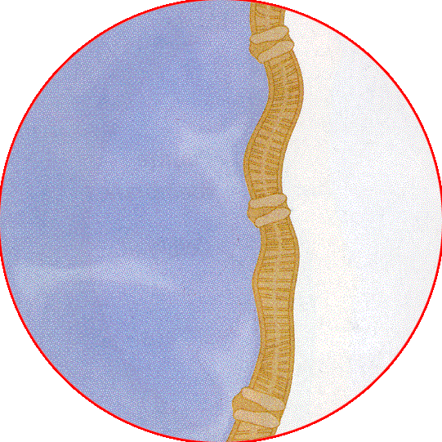
Purpose:
To act as a barrier between a cell and its environment
To maintain homeostasis in a cell (a balance of conditions suitable for life)

Slide 3
How?
The plasma membrane is selectively permeable, so it allows certain substances (like oxygen and nutrients) in, while getting rid of others (like waste.)

Slide 4
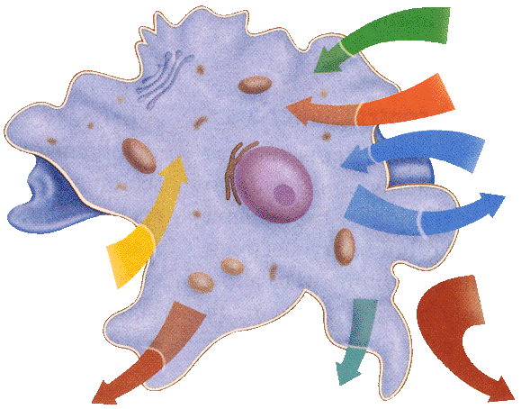
Summary Section 2 – pages 175-178
Plasma Membrane
Oxygen
Amino acids
Water
Glucose
Wastes
Wastes
Carbon dioxide
SELECTIVE PERMEABILITY

Slide 5
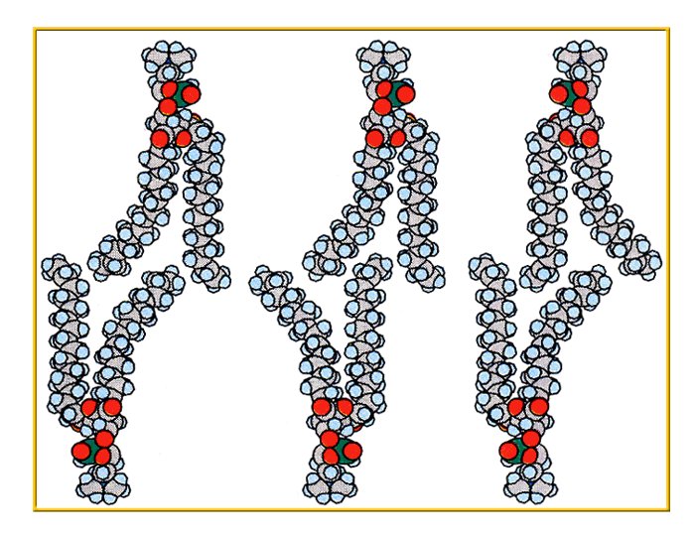
What does it look like?
It’s composed of a phospholipid bilayer
Polar heads (phosphate) on the outside
hydrophilic
Nonpolar tails (fatty acids) on the inside
hydrophobic
Two layers of phospholipids back-to-back

Slide 6
Polar heads: with phosphate group face outward and stay in contact with water inside and outside of cell
Nonpolar tails: fatty acid chains point inward toward one another.

Slide 7
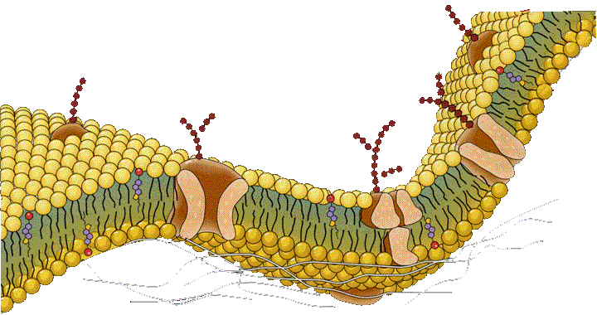
The Model
The model of the p.m. is called the fluid mosaic model because the phospholipids move within the membrane and proteins in the membrane move among the phospholipids.
It’s flexible

Slide 8
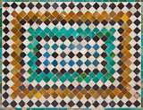
What does that mean?
“Fluid” means it can move (flow)
“Mosaic”
Animation
http://www.susanahalpine.com/anim/Life/memb.htm

Slide 9
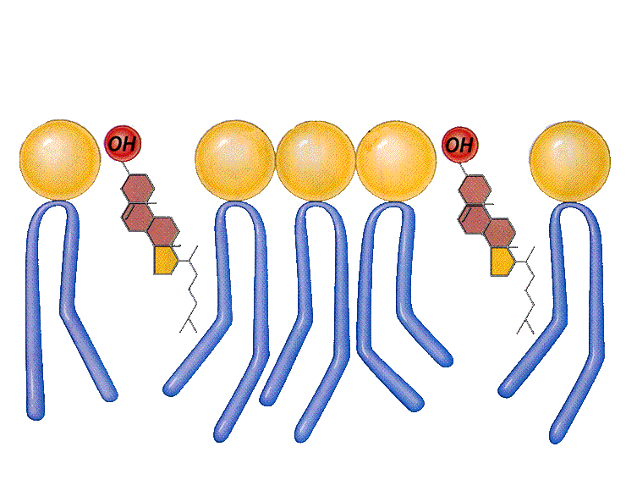
What are the other parts of the p.m.?
Cholesterol keeps the fatty acid tails from sticking together, keeps the membrane stable.
Carbohydrates stick out from the cell surface to help cells identify chemical signals.

Slide 10
Summary Section 2 – pages 175-178
Other components of the plasma membrane:
Transport proteins allow things to move through the plasma membrane.(2 types)
Channel protein – always open
Carrier protein – only open to certain substances

Slide 11
Section 2 Check
Question 1
Which of the following best describes the plasma membrane's mechanism in maintaining homeostasis?
A. protein synthesis
B. selective permeability
C. fluid composition
D. structural protein attachment

Slide 12
Section 2 Check
The answer is B. Selective permeability is the process in which the membrane allows some molecules to pass through, while keeping others out.

Slide 13
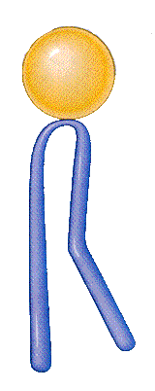
Section 2 Check
Question 2
Describe the structure of the plasma membrane.

Slide 14
Section 2 Check
The plasma membrane is composed of a phospholipid bilayer, which has two layers of phospholipids back-to-back. The polar heads of phospholipid molecules contain phosphate groups and face outward.

Slide 15
Section 2 Check
Question 3
Phospholipid molecule
Why is the phosphate group of a phospholipid important to the plasma membrane?
Polar head (includes phosphate group)
Nonpolar tails (fatty acids)

Slide 16
Section 2 Check
When phospholipid molecules form a bilayer, the phosphate groups lie to the outside. Because phosphate groups are polar, they allow the cell membrane to interact with its watery (polar) environments inside and outside the cell.
Phospholipid molecule
Polar head (includes phosphate group)
Nonpolar tails (fatty acids)

Slide 17
Section 2 Check
Question 4
Explain why the model of the plasma membrane is called the fluid mosaic model.

Slide 18
Section 2 Check
It is fluid because the phospholipid molecules move within the membrane. Proteins in the membrane that move among the phospholipids create the mosaic pattern.

