Slide 1
Chapter 10
Agenda:
Bellwork
Posters
Test Discussion
Notes

Slide 2
Chargaff analyzed the amounts of the four nucleotides found in DNA (Adenine, Thymine, Guanine, Cytosine) and noticed a pattern.

Slide 3
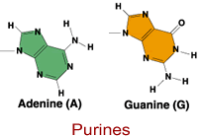
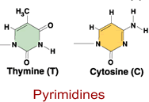
Bases
1. The amount of A, T, G, C varies from species to species 2. In each species, the amount of A = T, and the amount of G = C ---- Base Pair Rule Bases come in two types: pyrimidines (cytosine and thymine) and purines (guanine and adenine)

Slide 4
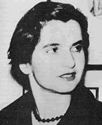
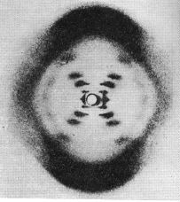
Rosalind Franklin
Rosalind Franklin and Wilkins spent time taking X-ray diffraction pictures of the DNA molecule in an attempt to determine the shape of the DNA molecule.

Slide 5
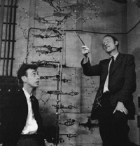
Watson and Crick are credited with finally piecing together all the information previously gathered on the molecule of DNA. They established the structure as a double helix - like a ladder that is twisted. The two sides of the ladder are held together by hydrogen bonds.

Slide 6
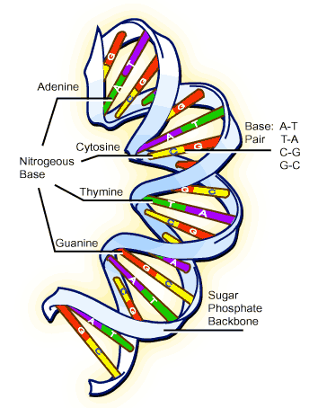
DNA
The sugar (deoxyribose) and phosphates make up the "backbone" of the DNA molecule.

Slide 7
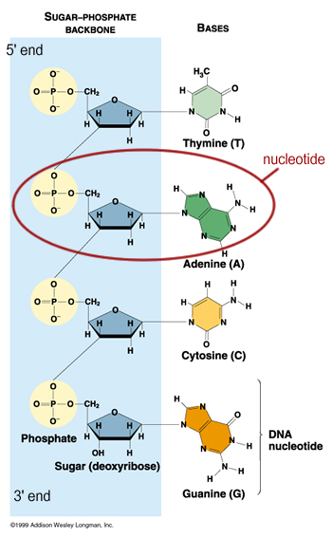
DNA
The phosphate is attached to the 5' carbon (the 5 is a number given to sugar molecules).

Slide 8
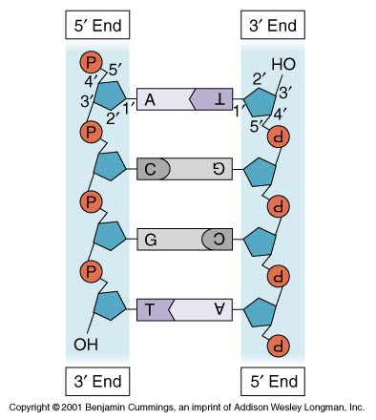
DNA
The DNA strand has a free phosphate on the 5' end, and a free sugar on the 3' end - these numbers will become important later.

Slide 9
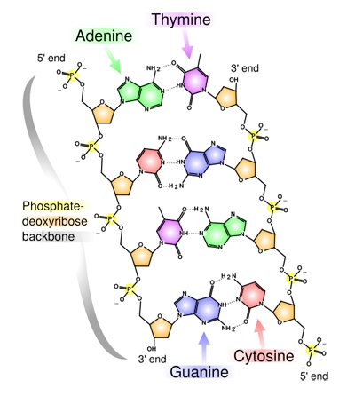
DNA
Adenine always pairs with Thymine
Guanine always pairs with Cytosine

Slide 10
DNA
Adenine always pairs with Thymine
Guanine always pairs with Cytosine
Side1:: A A T T G G C C A G A T A C Side2:: T T A A C C G G T C T A T G

Slide 11
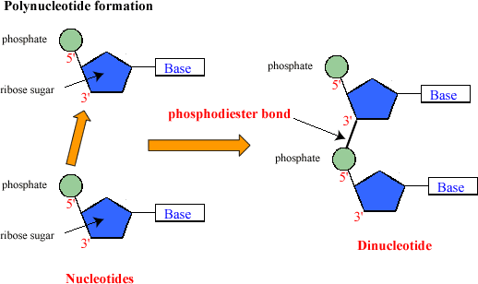
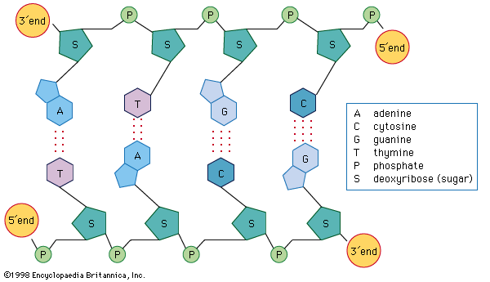
DNA
DNA is composed of subunits called nucleotides, strung together in a long chain -- Each nucleotide consists of: a phosphate, a sugar (deoxyribose), and a base

Slide 12
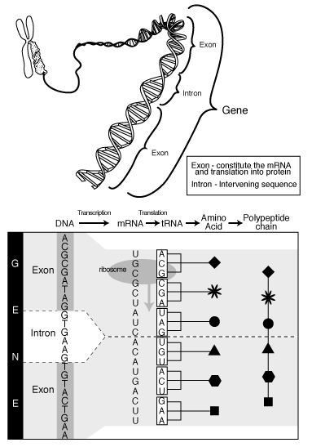
Genes specify a polypeptide (protein).

Slide 13
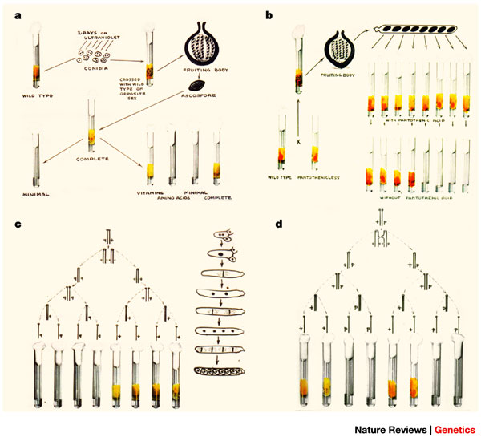
George Beadle’s Experiment showed that mutated bread mold will fail to make a particular enzyme and will not grow on minimal medium (“One Gene, One Enzyme Hypothesis”)

Slide 14
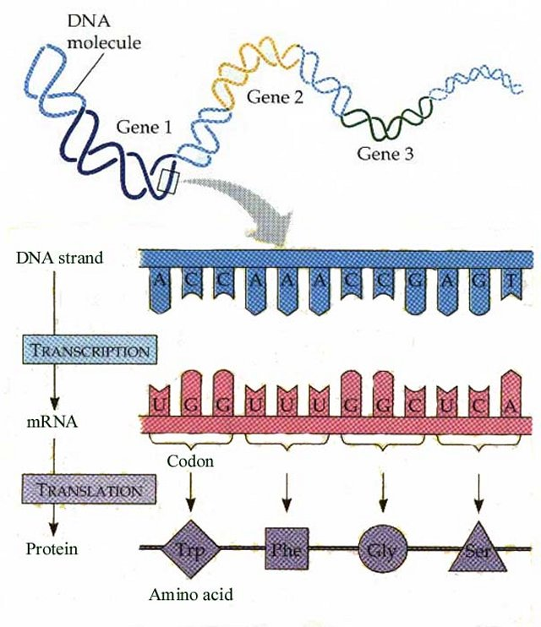
Conclusions: A gene is a segment of DNA that specifies the sequence of amino acids in a polypeptide of a protein. (This is the definition of a gene.)

Slide 15
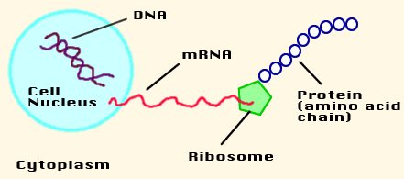
Chromosomes are made of DNA
Segments of DNA code for a protein
Protein in turn, relates to a trait (eye color, enzymes, hormones.)

Slide 16
Bellwork
Watch the BrainPop video.
http://www.brainpop.com/health/geneticsgrowthanddevelopment/rna/
Describe mRNA, tRNA, and rRNA.

Slide 17
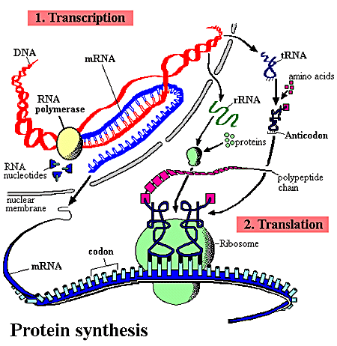
How Proteins are Synthesized from DNA
1. DNA is transcribed into mRNA (messenger RNA) 2. mRNA leaves the nucleus and travels to the cytoplasm 3. Ribosomes in the cytoplasm use the code on mRNA to translate it into amino acids 4. Amino acids form a chain - a protein

Slide 18
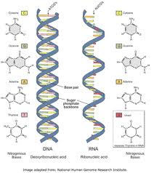
DNA RNA

Slide 19
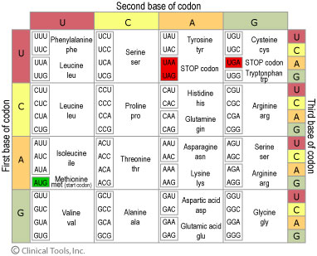
Codon

Slide 20
1. Three bases in mRNA make a “codon” , also called a “triplet” 2. Each codon specifies a single amino acid (you will need a chart)
3. Most amino acids have more than one codon (helps prevent effects of DNA mutations) 4. It is unambiguous (each codon has only one meaning)
5. The code has start and stop signals. (one start, three stops) 6. The code is universal – all living things share it (common evolutionary ancestors)
7. We can move genes from one organism to another (use bacteria to make insulin) because it is universal.

Slide 21
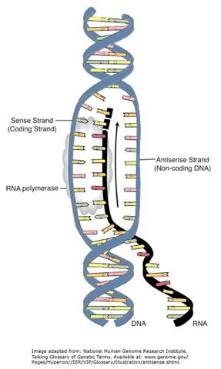
RNA
RNA is very similar to DNA with the following exceptions:
it is single stranded
it has uracil instead of thymine
it has the sugar ribose, instead of deoxyribose

Slide 22
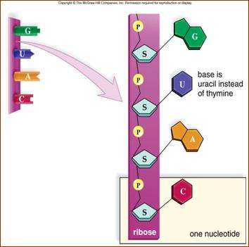
The base-pair rule is followed during transcription, except, instead of pairing thymine with adenine, when creating an RNA strand, uracil is used
DNA Strand:
T G C A T C A G A RNA Strand:
A C G U A G U C U

Slide 23
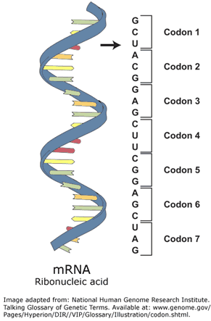
Transcription begins on the area of DNA that contains the gene. Each gene has three regions:
1. Promoter - turns the gene on or off, defines the start of a gene 2. Coding region - has the information on how to construct the protein 3. Termination sequence - signals the end of the gene

Slide 24
RNA Polymerase is responsible for reading the gene, and building the mRNA strand. It reads only the 3' to 5' strand.
Introns – areas of the RNA that will not be expressed (“junk DNA”) and are spliced out
Exons – areas of RNA that will be expressed
http://www.stolaf.edu/people/giannini/flashanimat/molgenetics/transcription.swf

Slide 25
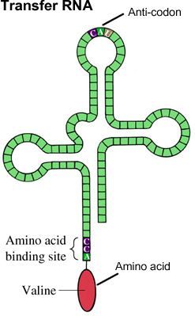
Translation
The mRNA travels to the cytoplasm
Amino acids exist freely in the cytoplasm, many of them you acquire from your diet
Each 3 bases (codon) translates to a single amino acid.
The ribosome looks for the "start" codon - AUG, this is where the chain begins

Slide 26
5. Transfer (tRNA), has an anticodon at one end and an amino acid at the other, it binds to a complementary codon.
6. Another tRNA reads the next codon, the amino acid attached to it binds with the amino acid on the previous tRNA using a peptide bond. The first tRNA falls off.
7. This process continues until the "stop" codon is reached.
8. The amino acid chain folds into a 3 dimensional structure, now a protein.That protein can be an enzyme, a hormone, etc.

Slide 27
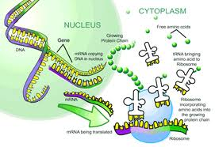
http://www.stolaf.edu/people/giannini/flashanimat/molgenetics/translation.swf

Slide 28
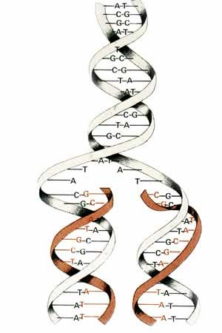
DNA Replication
the process by which DNA makes a copy of itself
occurs during interphase, prior to cell division

Slide 29
DNA Replication
1. DNA helicase (enzyme) unwinds the DNA. The junction between the unwound part and the open part is called a replication fork. 2. DNA polymerase adds the complementary nucleotides and binds the sugars and phosphates. DNA polymerase travels from the 3' to the 5' end. The DNA is called the template strand.

Slide 30
DNA Replication
3. DNA polymerase adds complementary nucleotides on the other side of the ladder. Traveling in the opposite direction. 4. One side is the leading strand - it follows the helicase as it unwinds. 5. The other side is the lagging strand - its moving away from the helicase (in the 5' to 3' direction).

Slide 31
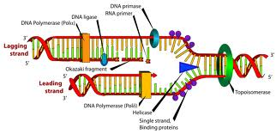
Replication is called semi-conservative, because one half of the original strand is always saved, or "conserved"

Slide 32
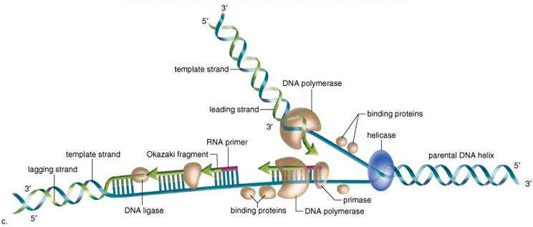
Problem: it reaches the replication fork, but the helicase is moving in the opposite direction. It stops, and another polymerase binds farther down the chain.
This process creates several fragments, called Okazaki Fragments, that are bound together by DNA ligase.

Slide 33
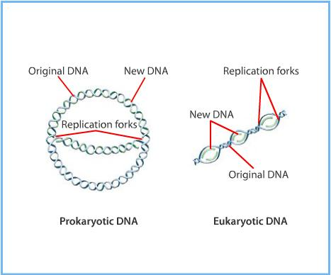
During replication, there are many points along the DNA that are synthesized at the same time (multiple replication forks). It would take forever to go from one end to the other, it is more efficient to open up several points at one time.

Slide 34
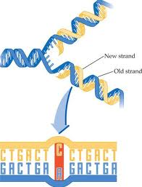
Replication Errors
can cause a genetic MUTATION
PROOFREADING by the polymerase prevents mismatches
DNA REPAIR ENZYMES can repair damaged DNA also

